Slide 1

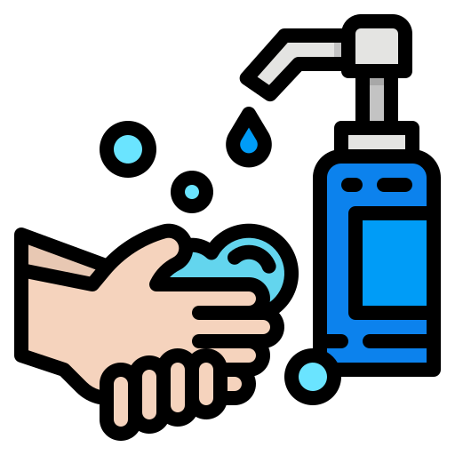
Alpha Optimus
Project ‘GORONA’

Slide 2

Survey
Till 30th October about 505,454 (according to WHO) the rate of new cases of Coronavirus diseases has found. In India, till now about 121,000 people died of this virus. The most affected persons (1.89M) and deaths (145,000) are from Maharashtra, India.
The rate of New cases was the highest in number from 25th August to October 15th in India. Overall data shows a great tragedy of the world for Covid-19 virus.

Slide 3



Problem
The researcher and scientists are busy with making of vaccine. We have sanitizer and cleaning system for our safety but we don’t have proper purified system.
We can’t stop spreading of Covid-19 virus but we can prevent it with proper technology and method.

Slide 4



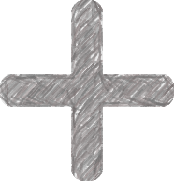
Solution
For the first time of the world, we’ve come up with an idea of a modified device which can lessen the rate more efficiently than the previous ones.
UV light
Body Cleaner Spray
A device which will spray the room while a person will enter there besides that it can spread the UV light for the 99.99% cleanliness. As we know the UV ray can demolish the coronavirus. It can also destroy the virus if it is contaminated with the air. This
device will spray UV ray in absence of the human.

Slide 5
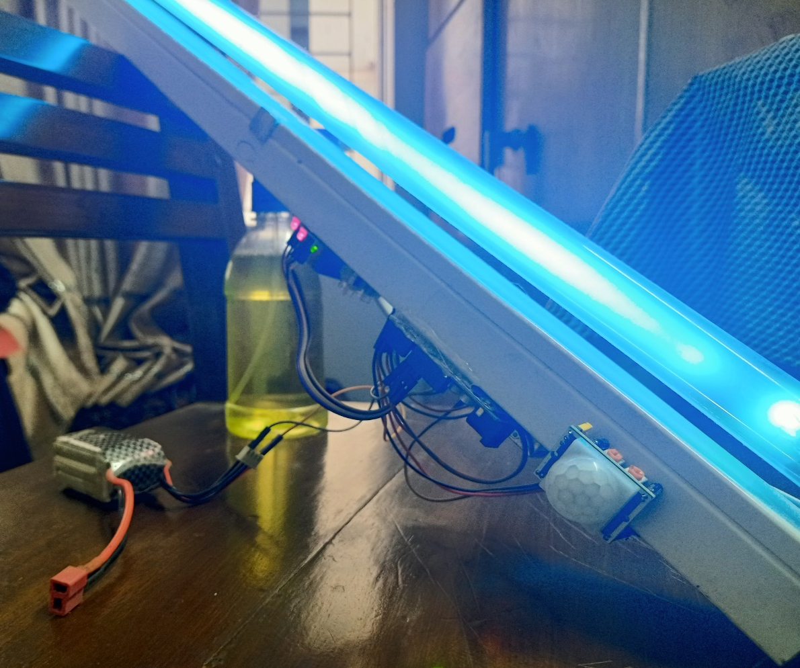
GORONA
A device to save human life

Slide 6


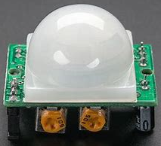
Components
• UV light • PIR sensor • Microcontroller (Arduino) • Lipo battery • 5V Relay module • Water Container • Pipe & Nozzle • Water Pump
Arduino
It is hard to find the automated device which will clean your room or area. The UV spray with the cleaner will kill the germ. We use it as an antiseptic disinfectant liquid as it is a concentrated antiseptic solution. Provides protection against germs which can cause infection and illness. This is unique and rare to find something which can clean a place in two different ways with a device autonomously.
PIR Sensor

Slide 7
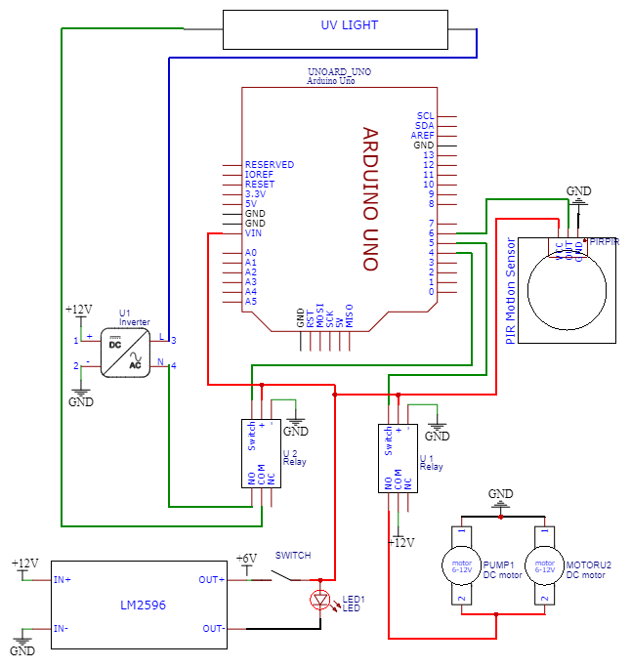
Circuit design
This circuit design has been created with the Proteus app

Slide 8

Mechanism
At first, when the person will enter the room the PIR sensor will be activated. And when they will go out from the room the value of the sensor will be 0. So, at first the 1st relay will be activated and the spray will the outsider who is entering into the room. After the spray ends within 20 seconds the person can enter into the room. Before entering into the room, while there is no one staying, the 2nd relay will be activated and the UV light will light on and it will disinfect the room for 60 seconds.
We can connect and disconnect the device in the wireless process. By using an HC05 Bluetooth or WIFI module that can be controlled from out of the range. There will be a single container to clean the germs of human body. The basis on the demand the size of this module can be changed.

Slide 9

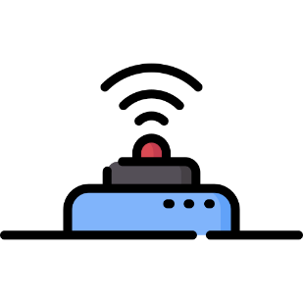


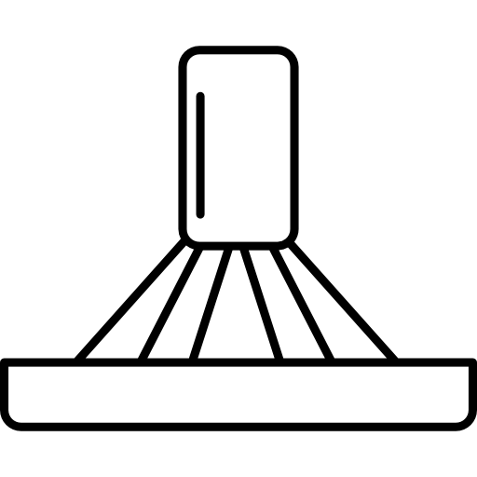



Process
PIR Value 0
PIR Sensor
PIR Value 1
UV Light
Nozzle
Germ Cleaner

Slide 10


Business plan
The model we have conducted is 3c model. For our business, we have two types of customers as Niche market and mass market. Importer, exporter, distributor, whole seller are from niche market. For mass market, we have all types of people who want to ensure safety for themselves.
We have NO competitors in the market

Slide 11

Finance
1st Stage
2nd Stage
Revenue
120,184
INR
10,92,589
INR
Profit
48,646
INR
442,238
INR

Slide 12
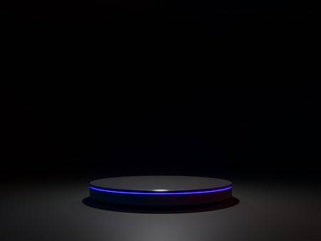
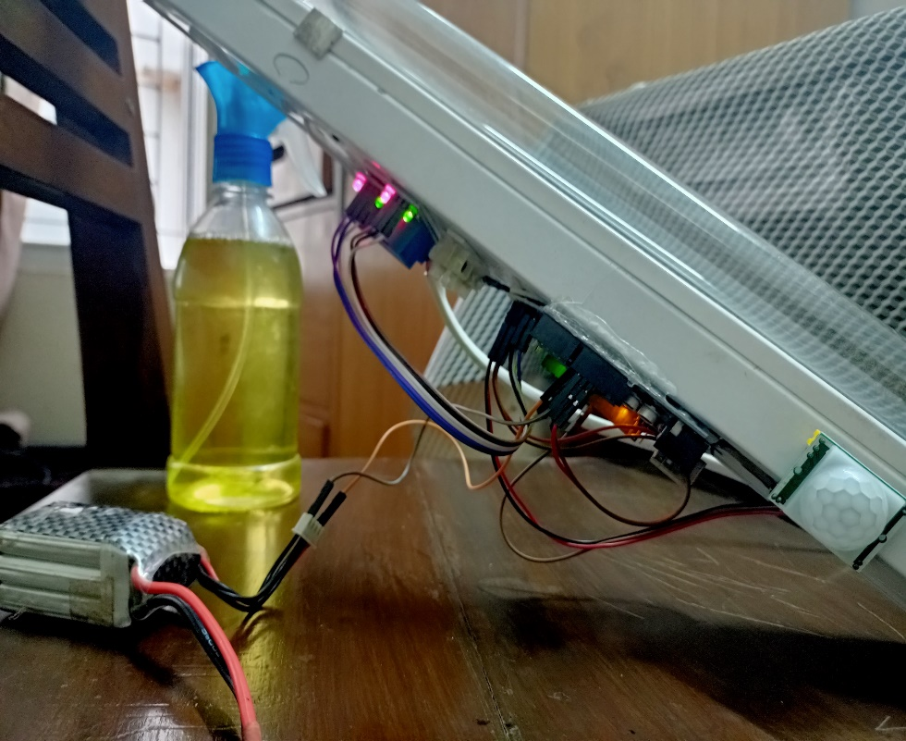
Digital device
WORLD’S FIRST
98%
Accuracy
Starting from
15$
Price reduced
75%

Slide 13
The drive link for the video:
https://drive.google.com/drive/folders/1YvEcDMh91SgQvjetKm05soFg67KI_A9D?usp=sharing
Github link:

